Slide 1
Buffer Overflow Attack
Défense Techniques
Notes:
Introduction

Slide 2
Countermeasures
We can take countermeasures at different points in time
  before we even begin programming
  during development
  when testing
  when executing code
to prevent, to detect – at (pre)compile time or at runtime -, and to migitate problems with buffer overflows
Buffer Overflow: Defense Techniques

Slide 3
Preventing Buffer Overflow Attacks
Non-executable stack
Static source code analysis.
Run time checking: StackGuard, Libsafe, SafeC, (Purify).
Randomization.
Type safe languages (Java, ML).
Detection deviation of program behavior
Sandboxing
Access control …
Buffer Overflow: Defense Techniques

Slide 4
Prevention
Don’t use C or C++ (use type-safe language)
  Legacy code
  Practical?
Better programmer awareness & training
  Building Secure Software, J. Viega & G. McGraw, 2002
  Writing Secure Code, M. Howard & D. LeBlanc, 2002
  19 deadly sins of software security, M. Howard, D LeBlanc & J. Viega, 2005
  Secure programming for Linux and UNIX HOWTO, D. Wheeler, www.dwheeler.com/secure-programs
  Secure C coding, T. Sirainen www.irccrew.org/~cras/security/c-guide.html
Buffer Overflow: Defense Techniques

Slide 5
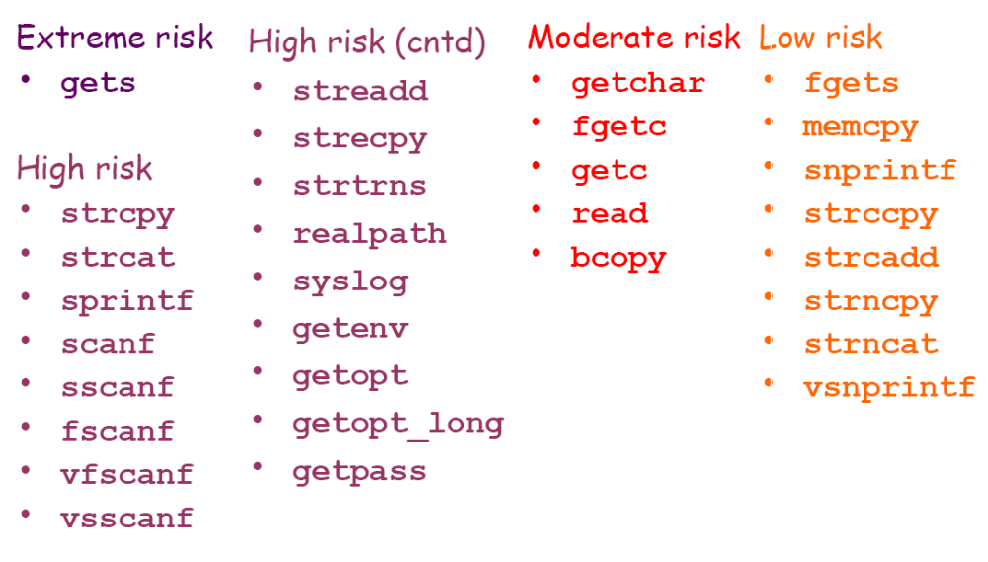
Dangerous C system calls source: Building secure software, J. Viega & G. McGraw, 2002
Buffer Overflow: Defense Techniques

Slide 6
Secure Coding
Avoid risky programming constructs
  Use fgets instead of gets
  Use strn* APIs instead of str* APIs
  Use snprintf instead of sprintf and vsprintf
  scanf & printf: use format strings
Never assume anything about inputs
  Negative value, big value
  Very long strings
Buffer Overflow: Defense Techniques

Slide 7
Prevention – use better string libraries
there is a choice between using statically vs dynamically allocated buffers
  static approach easy to get wrong, and chopping user input may still have unwanted effects
  dynamic approach susceptible to out-of-memory errors, and need for failing safely
Buffer Overflow: Defense Techniques

Slide 8
Better string libraries
libsafe.h provides safer, modified versions of eg strcpy
strlcpy(dst,src,size) and strlcat(dst,src,size) with size the size of dst, not the maximum length copied.
  Used in OpenBSD
glib.h provides Gstring type for dynamically growing null-terminated strings in C
  but failure to allocate will result in crash that cannot be intercepted, which may not be acceptable
Strsafe.h by Microsoft guarantees null-termination and always takes destination size as argument
C++ string class
  data() and c-str()return low level C strings, ie char*, with result of data()is not always null-terminated on all platforms...
Buffer Overflow: Defense Techniques

Slide 9
Dynamic countermeasures
Protection by kernel
  Non-executable stack memory (NOEXEC)
    prevents attacker executing her code
  Address space layout randomisation (ASLR)
    generally makes attacker's life harder
      E.g., harder to get return address place and injected code address
Protection inserted by the compiler
  to prevent or detect malicious changes to the stack
Neither prevents against heap overflows
Buffer Overflow: Defense Techniques

Slide 10
Bugs to Detect in Source Code Analysis
Some examples
Crash Causing Defects
Null pointer dereference
Use after free
Double free
Array indexing errors
Mismatched array new/delete
Potential stack overrun
Potential heap overrun
Return pointers to local variables
Logically inconsistent code
Uninitialized variables
Invalid use of negative values
Passing large parameters by value
Underallocations of dynamic data
Memory leaks
File handle leaks
Network resource leaks
Unused values
Unhandled return codes
Use of invalid iterators
Buffer Overflow: Defense Techniques

Slide 11
Marking stack as non-execute
Basic stack exploit can be prevented by marking stack segment as non-executable or randomizing stack location.
  Then injected code on stack cannot run
  Code patches exist for Linux and Solaris
    E.g., our olympus.eecs.ucf.edu has patched for stack radnomization
Problems:
  Does not block more general overflow exploits:
    Overflow on heap, overflow func pointer
  Does not defend against `return-to-libc’ exploit.
  Some apps need executable stack (e.g. LISP interpreters).
Buffer Overflow: Defense Techniques

Slide 12
Randomization Techniques
For successful exploit, the attacker needs to know where to jump to, i.e.,
  Stack layout for stack smashing attacks
  Heap layout for code injection in heap
  Shared library entry points for exploits using shared library
Randomization Techniques for Software Security
  Randomize system internal details
    Memory layout
    Internal interfaces
  Improve software system security
    Reduce attacker knowledge of system detail to thwart exploit
    Level of indirection as access control
Buffer Overflow: Defense Techniques

Slide 13
Randomize Memory Layout (I)
Randomize stack starting point
  Modify execve() system call in Linux kernel
  Similar techniques apply to randomize heap starting point
Randomize heap starting point
Randomize variable layout
Buffer Overflow: Defense Techniques

Slide 14
Randomize Memory Layout (II)
Handle a variety of memory safety vulnerabilities
  Buffer overruns
  Format string vulnerabilities
  Integer overflow
  Double free
Simple & Efficient
  Extremely low performance overhead
Problems
  Attacks can still happen
    Overwrite data
    May crash the program
  Attacks may learn the randomization secret
    Format string attacks
Buffer Overflow: Defense Techniques

Slide 15
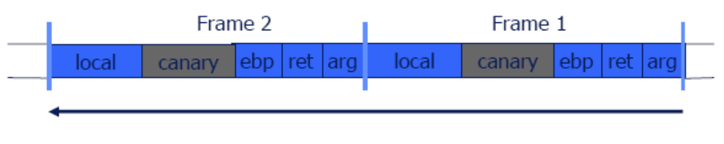
Dynamic countermeasure: stackGuard
Solution: StackGuard
  Run time tests for stack integrity.
  Embed “canaries” in stack frames and verify their integrity prior to function return.
Buffer Overflow: Defense Techniques

Slide 16
Canary Types
Random canary:
  Choose random string at program startup.
  Insert canary string into every stack frame.
  Verify canary before returning from function.
  To corrupt random canary, attacker must learn the random string.
Buffer Overflow: Defense Techniques

Slide 17
Canary Types
Additional countermeasures:
  use a random value for the canary
  XOR this random value with the return address
  include string termination characters in the canary value (why?)
Buffer Overflow: Defense Techniques

Slide 18
StackGuard implemented as a GCC patch
  Program must be recompiled
Low performance effects: 8% foR Apache
Problem
  Only protect stack activation record (return address, saved ebp value)
Buffer Overflow: Defense Techniques

Slide 19
Purify
A tool that developers and testers use to find memory leaks and access errors.
Detects the following at the point of occurrence:
  reads or writes to freed memory.
  reads or writes beyond an array boundary.
  reads from uninitialized memory.
Buffer Overflow: Defense Techniques

Slide 20
Purify - Catching Array Bounds Violations
To catch array bounds violations, Purify allocates a small "red-zone" at the beginning and end of each block returned by malloc.
The bytes in the red-zone → recorded as unallocated.
If a program accesses these bytes, Purify signals an array bounds error.
Problem:
  Does not check things on the stack
  Extremely expensive
Buffer Overflow: Defense Techniques

Slide 21
Further improvements
PointGuard
  also protects other data values, eg function pointers, with canaries
    Higher performance impact than stackGuard
ProPolice's Stack Smashing Protection (SSP) by IBM
  also re-orders stack elements to reduce potential for trouble
Stackshield has a special stack for return addresses, and can disallow function pointers to the data segment
Buffer Overflow: Defense Techniques

Slide 22
Dynamic countermeasures
libsafe library prevents buffer overruns beyond current stack frame in the dangerous functions it redefines
  Dynamically loaded library.
  Intercepts calls to strcpy (dest, src)
    Validates sufficient space in current stack frame:
    |frame-pointer – dest| > strlen(src)
    If so, does strcpy.
    Otherwise, terminates application.
Buffer Overflow: Defense Techniques

Slide 23
Dynamic countermeasures
libverify enhancement of libsafe keeps copies of the stack return address on the heap, and checks if these match
Buffer Overflow: Defense Techniques

Slide 24
None of these protections are perfect!
  even if attacks to return addresses are caught, integrity of other data other than the stack can still be abused
  clever attacks may leave canaries intact
  where do you store the "master" canary value
    a cleverer attack could change it
  none of this protects against heap overflows
    eg buffer overflow within a struct...
  New proposed non-control attack
Buffer Overflow: Defense Techniques

Slide 25
Summary
Buffer overflows are the top security vulnerability
Any C(++) code acting on untrusted input is at risk
Getting rid of buffer overflow weaknesses in C(++) code is hard (and may prove to be impossible)
  Ongoing arms race between countermeasures and ever more clever attacks.
  Attacks are not only getting cleverer, using them is getting easier
Buffer Overflow: Defense Techniques

